Slide 1

Report-14 Feb
Wisjul fighter

Slide 2

Content
Controller
PSO and result
Next Plan

Slide 3

Controller

Slide 4
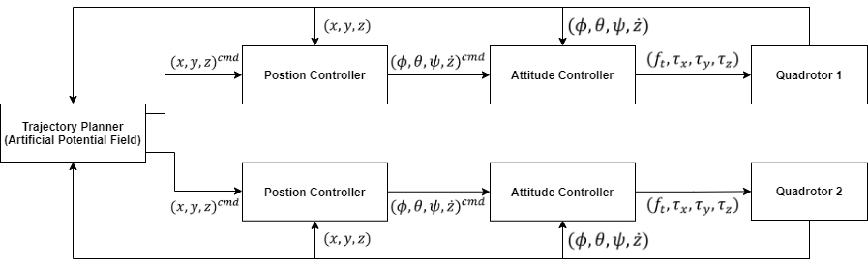
Diagram Block

Slide 5
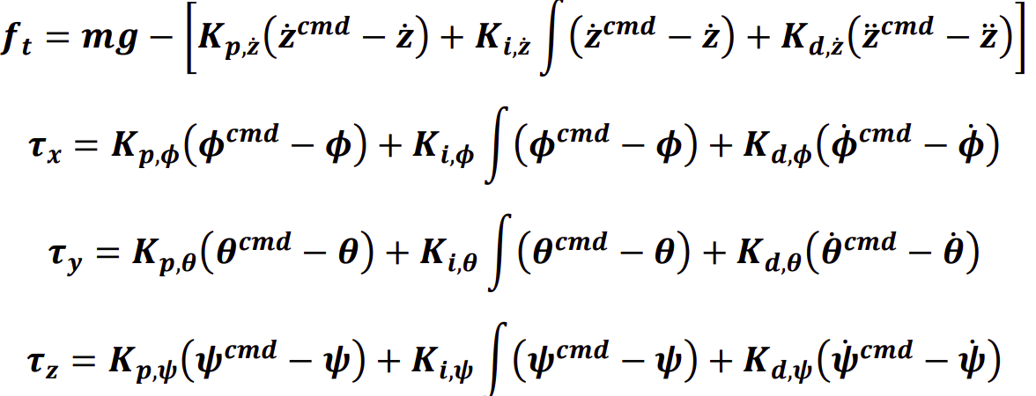
Equation – Attitude Controller

Slide 6
Equation – Position Controller
In Revision (Adding Yaw)

Slide 7
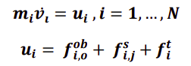
Equation – Trajectory Planner (1)

Slide 8
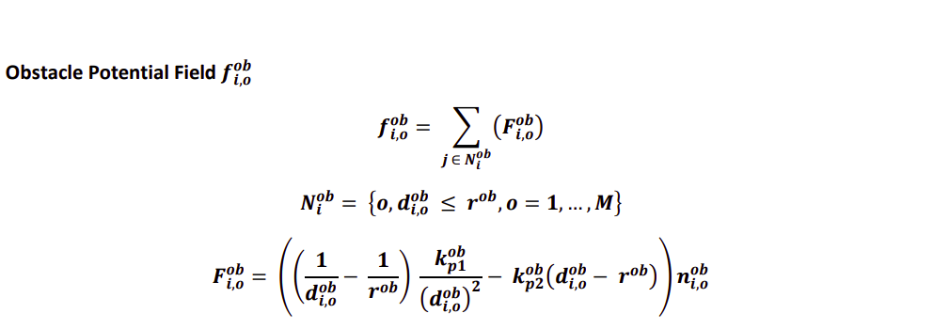
Equation – Trajectory Planner (2)

Slide 9
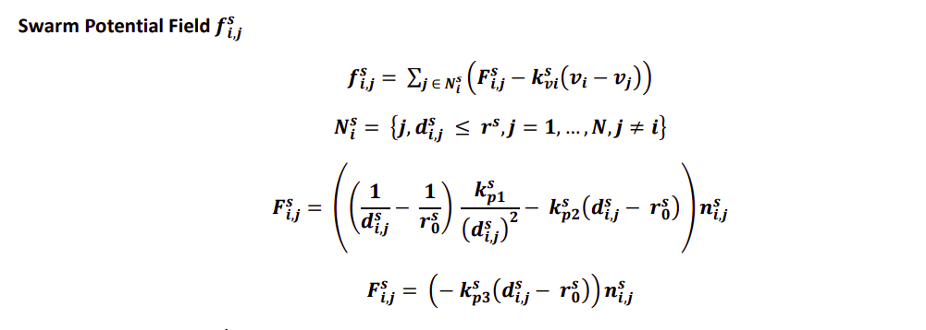
Equation – Trajectory Planner (3)

Slide 10
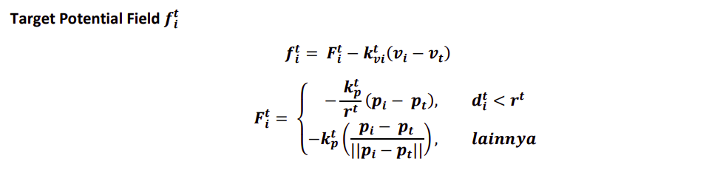
Equation – Trajectory Planner (4)

Slide 11

PSO

Slide 12
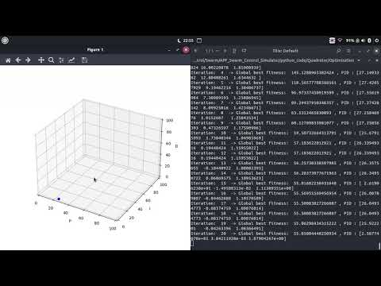
Animation

Slide 13

Result

Slide 14
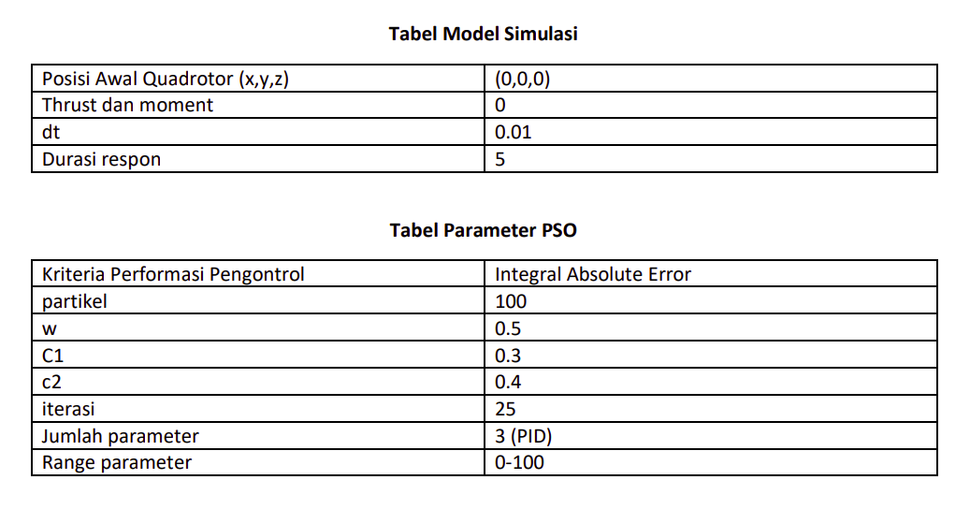
PSO

Slide 15
Constraint
Parameter Pengontrol PID (Kp, Ki, Kd) attitude lain = (0,0,0)

Slide 16
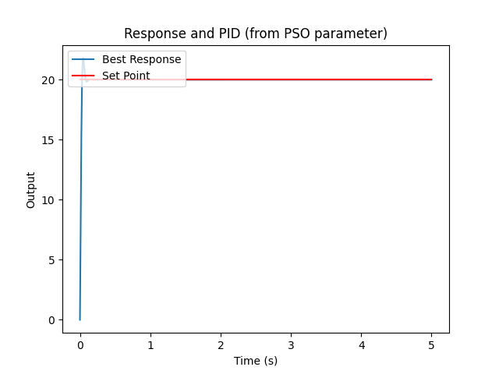
Setpoint phi 20 degree

Slide 17
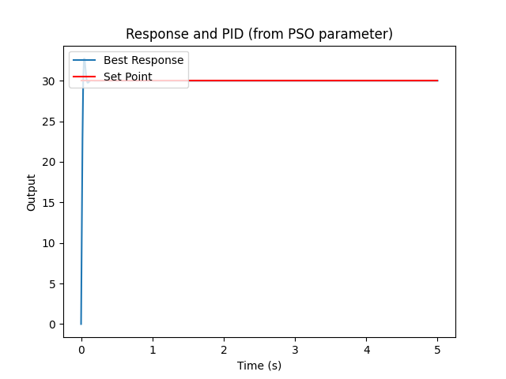
Setpoint phi 30 degree

Slide 18

Setpoint theta 20 degree

Slide 19
Setpoint theta 30 degree

Slide 20

Setpoint psi 20 degree

Slide 21

Setpoint psi 30 degree

Slide 22
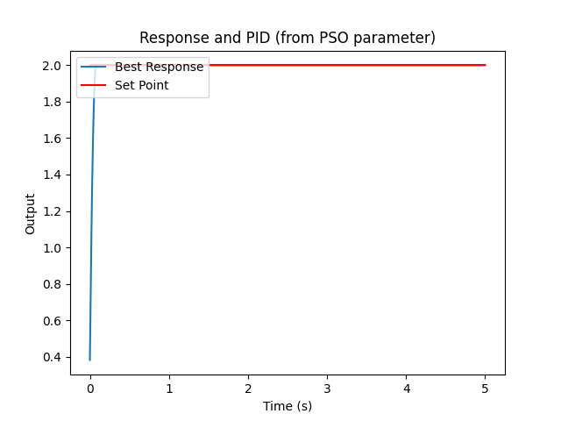
Setpoint zdot 2m/s

Slide 23
Parameter yang berubah
Posisi awal = (0,0,5)

Slide 24
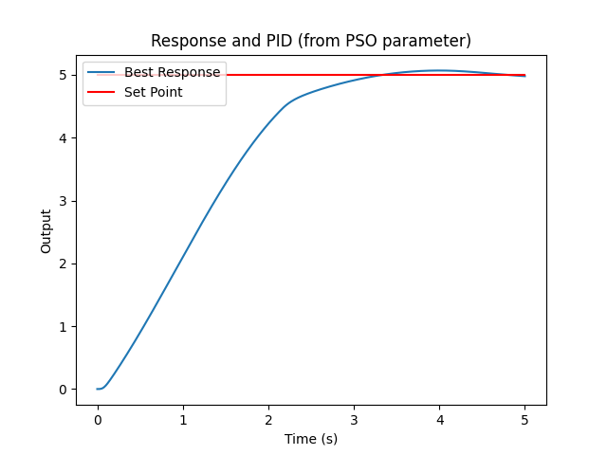
Setpoint x = 5m

Slide 25
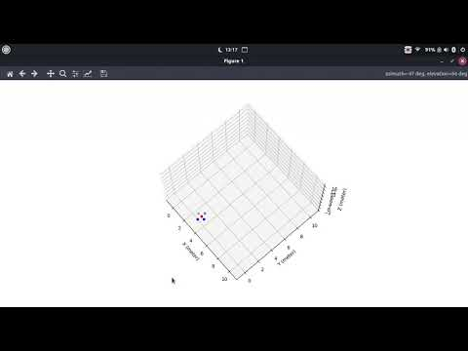
Setpoint x = 5m Animation

Slide 26
Setpoint y = 5m

Slide 27
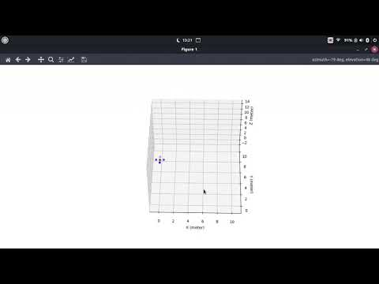
Setpoint y = 5m Animation

Slide 28
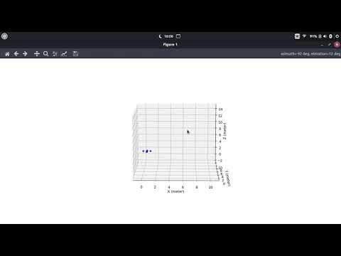
Setpoint (0.7, 2, 0) Animation

Slide 29
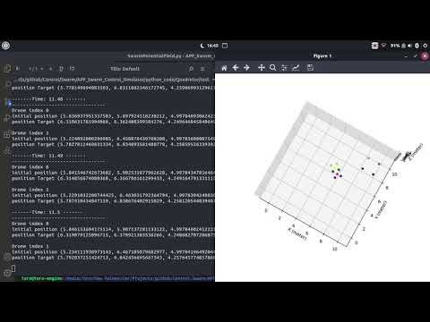
Testing Swarm Control (without obstacle but with target) the target = ship (4 black dots)

Slide 30

Next Plan

Slide 31
NEXT PLAN
Preparation for Implementation (check Tello)
Finish Position Controller with Yaw
Add obstacle in the simulation
Trying 3 Quadrotor in Simulation

